Slide 1
CS4770 Introduction to Software Security
By Chad Mourning

Slide 2
What to teach?
There is too much about security to be taught in 1 class, so we have to pick a subset.
https://cybered.hosting.acm.org/wp-content/uploads/2018/02/newcover_csec2017.pdf
The ACM has a nice set of guidelines on what people should learn in cybersecurity.
These align well with the textbook for this class.
These are an update of the 2013 guidelines.
Last year I had a paper rejected because I didn’t cite these guidelines as the basis for a workshop we ran.
It is divided into Knowledge Areas, Units, and Topics. (Chapter 4)

Slide 3
Standards Bodies
Throughout this course we may reference various standards bodies that make security rules and recommendations.
NIST – National Institute of Standards and Technology
They issue FIPS – Federal Information Processing Standards
They also have money and fund research (they are part of the Department of Commerce) – I think we got some money to make sure our research areas were NIST compliant.
ISOC – The Internet Society, a professional organization akin to the ACM or IEEE
The IETF – Internet Engineering Task Force is part of this, formed in 1986
Issues RFCs (Request For Comments) to help inform standards.
Be careful is one is dated April 1st.
So is the IAB – Internet Architecture Board
ITU – International Telecomunications Union
I cited a few of their standards, on video compression, in my dissertation.
ISO – International Organization for Standards.
When the letters are backwards assume it’s French, but in this case it’s a joke
Iso is Greek for “the same”, clever name for a standards body

Slide 4
What is Computer Security
NIST – “The protection afforded to an automated information system in order to attain the applicable objectives of preserving the integrity, availability, and confidentiality of information system resources (includes hardware, software, firmware, information/data, and telecommunications).”
It’s being using this definition since at last 1995.

Slide 5
Confidentiality
Data confidentiality - Assures that private or confidential information is not made available or disclosed to unauthorized individuals.
Think securing access.
FERPA, for example. Or your tax return.
Privacy - Assures that individuals control or influence what information related to them may be collected and stored and by whom and to whom that information may be disclosed.
Think securing channels of communication.

Slide 6
Integrity
Data integrity - Assures that information and programs are changed only in a specified and authorized manner.
This is what those md5 checksums you ignore on the internet are for.
Medical records, like pharmaceutical allergies.
System integrity - Assures that a system performs its intended function in an unimpaired manner, free from deliberate or inadvertent unauthorized manipulation of the system.
Think “computer viruses”

Slide 7
Availability
Assures that systems work promptly and service is not denied to authorized users.
Obvious example, denial-of-service attacks.

Slide 8
Aside: MD5 Hashes
How to calculate an MD5 hash on linux.
md5sum filename
Live demo!
No package necessary, was built straight into ubuntu
Don’t use md5, it’s vulnerable to collision attacks
Assignment idea?

Slide 9
With You Powers Combined
We sometimes call these the C-I-A Triad
Not that CIA, but I assume the irony isn’t lost on them.
Sometimes the following are appended:
Authenticity, but I think this is captured by Integrity
Accountability, sort to tied into integrity, but the opposite of authenticity.
Authenticity is being able to prove that you sent a message.
Accountability, is related to non-repudiation, or the ability to prove someone else sent a message.
Important for detecting fraud.

Slide 10
How bad is it?
FIPS 199 defines 3 levels of severity to a breach of cybersecurity. Conveniently these are:
Low (limited)
Medium (severe)
High (catastrophic)

Slide 11
Challenges in Cybersecurity

Slide 12
There is a lot of it
Really too much for one class, but we have to start somewhere.
A real cybersecurity curriculum would require more networking and math than I could reasonably include in the course, or list as prereqs.
MATH 3070 – Number Theory is a good course for the cyber interested, if you still haven’t taken your “other math or science” requirement.

Slide 13
A Different Mindset
Until know, most of you probably focuses on the correctness of your application, not considering that security is part of correctness (unless your insecurity is intentional?)
Hopefully, some of the lessons in class will help you foresee vulnerabilities in your programs
Since most of you will get jobs writing programs that will be used by others.

Slide 14
Competing Interests
The more security you add, the more complexity and inefficiency there is in your end product.
Also the more time it will take to develop, which costs money.
But a data breach will probably cost your company more.
Don’t be short sighted.
Even more nuanced competing interests include philosophy
Should the security go in the library, or be on top of it
Every library should be good at exactly 1 thing, right?
A system so least privilege, the devs can’t even change the source code.

Slide 15
This ain’t a program, it’s an arms race
Every minute you spend thinking about security, there may be 100 other people thinking about how to break it.

Slide 16
It could never happen to me
Your stakeholders won’t value security until it’s too late
Make good decisions. – General Life Advice

Slide 17
Life is suffering
Good security hygiene will require constant patching and updating of software which may break things
We’ll talk about Spectre and Meltdown later, but there was speculation when it first happened that it may lead to a permanent 20% decrease in efficiency by removing branch prediction.
NIST standards require explicit review of logs which costs manpower.

Slide 18
Education
We could solve a lot of problems in this life if everyone knew how to generate a pair of 2048-bit keys to use as their identity, but good luck teaching this to your grandparents.
Abstract as much as you can, but it’s still very possible that any increase in security is also an increase in convivence for your users.

Slide 19
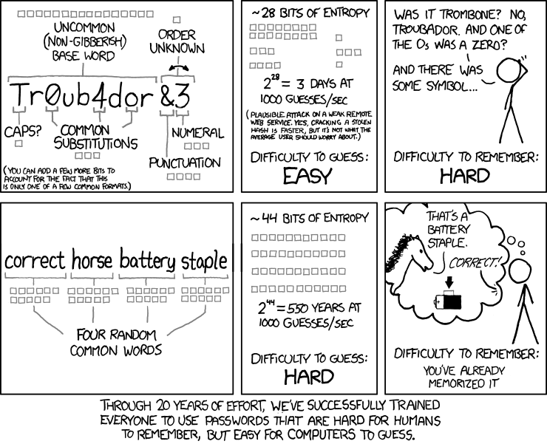
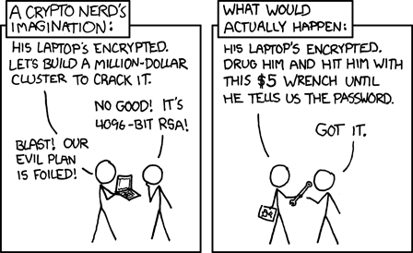
Relevant XKCDs
Passwords are dumb.
And weird password rules are dumber.

Slide 20
Challenges in Cybersecurity

Slide 21
Vocab
Adversary – An entity that attacks or is a threat to a system, could be a person, foreign country, AI, etc.
Attack - An assault on system security that derives from an intelligent threat; that is, an intelligent act that is a deliberate attempt (especially in the sense of a method or technique) to evade security services and violate the security policy of a system.
Countermeasure - An action, device, procedure, or technique that reduces a threat, a vulnerability, or an attack by eliminating or preventing it, by minimizing the harm it can cause, or by discovering and reporting it so that corrective action can be taken.
Risk - An expectation of loss expressed as the probability that a particular threat will exploit a particular vulnerability with a particular harmful result.
Security Policy - A set of rules and practices that specify or regulate how a system or organization provides security services to protect sensitive and critical system resources.
System Resource (Asset) - Data contained in an information system; or a service provided by a system; or a system capability, such as processing power or communication bandwidth; or an item of system equipment (i.e., a system component— hardware, firmware, software, or documentation); or a facility that houses system operations and equipment.
Threat - A potential for violation of security, which exists when there is a circumstance, capability, action, or event, that could breach security and cause harm. That is, a threat is a possible danger that might exploit a vulnerability.
Vulnerability - A flaw or weakness in a system’s design, implementation, or operation and management that could be exploited to violate the system’s security policy

Slide 22
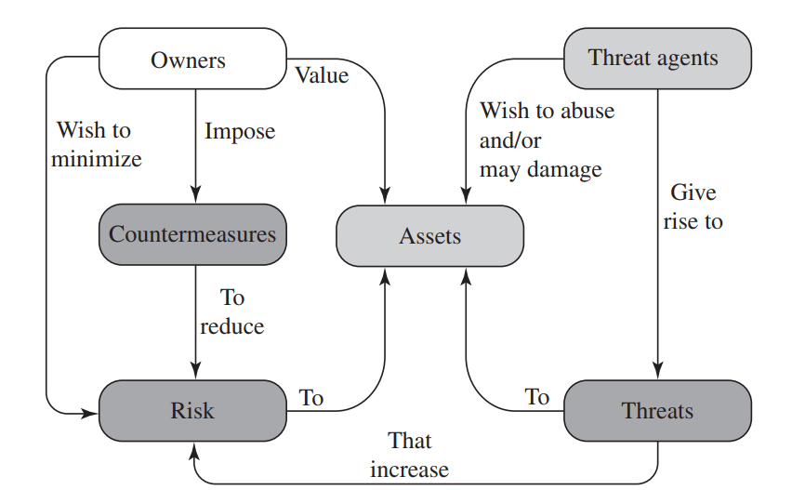
Security Concepts and Relationships

Slide 23
Assets in Detail
Hardware – CPU, GPU, Storage,
Software – Often as an access point to other resources.
Data – General files, personal data, password lists
Comms – Botnets for DDoS

Slide 24
Vulnerabilities Taxonomy
Leaky (anti-confidentiality) – unwanted entities can get access
Corrupted (anti-integrity) – results may differ from what is expected
Unavailable (anti-availability) – slow or unavailable

Slide 25
Attack Taxonomy
Passive vs. Active
Passive is usually probing, trying to learn more about a system, usually planning for an active attack later.
Insider vs. Outsider
Insiders usually have intimate knowledge of how a system works
Outsiders have to act mostly blind
Prevention vs. Recovery
Countermeasures are used to prevent attacks
Forensics may be used detect that an attack occurred, how the attack occurred, and the results.

Slide 26
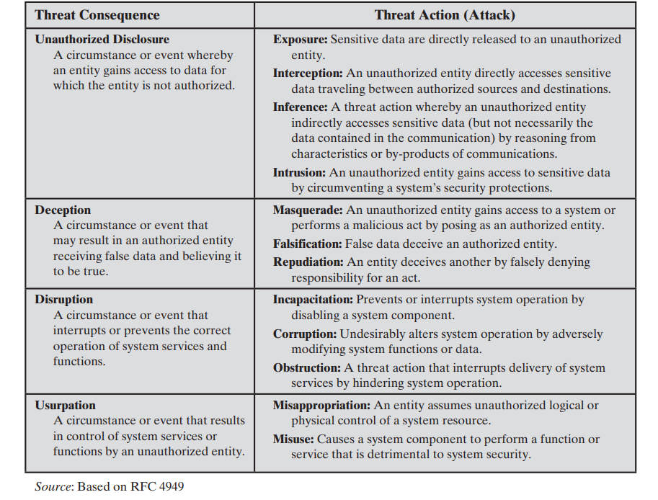
Attack Taxonomy, Cont.

Slide 27
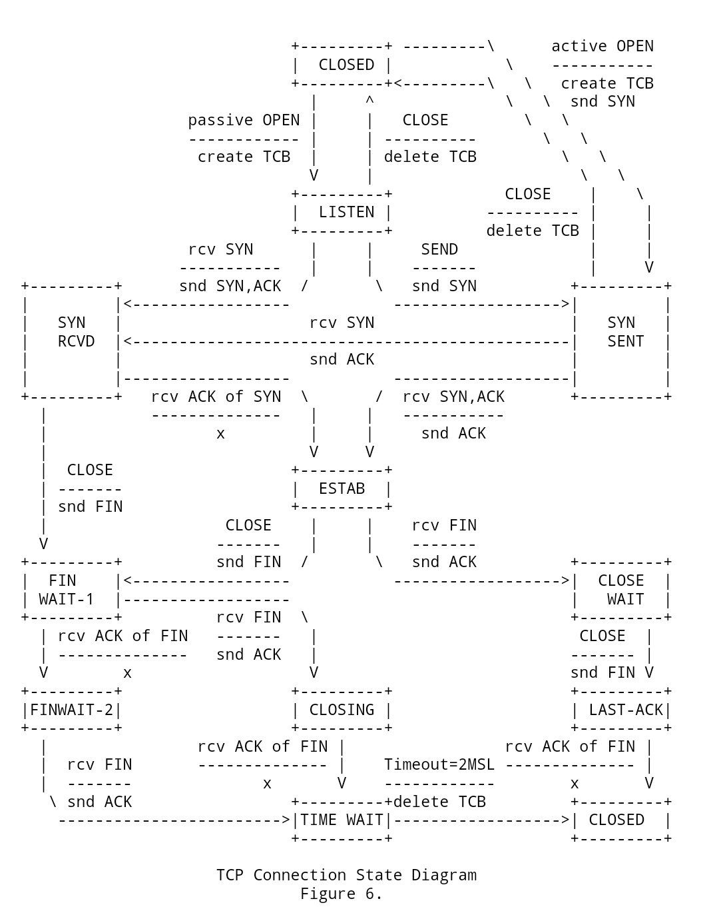
Aside: RFCs
https://www.rfc-editor.org/rfc/rfc4949
https://www.rfc-editor.org/rfc/rfc8140.html

Slide 28
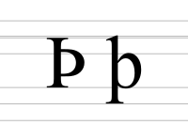


Aside: Aside: Thorns
“It is unclear which of Dr. Mourning’s material is intended to be retained.” – Anonymous Student on Evaluation

Slide 29
Attack Taxonomy: Unauthorized Disclosure
Interception - Interception is a common attack in the context of communications. On a shared local area network (LAN), such as a wireless LAN or a broadcast Ethernet, any device attached to the LAN can receive a copy of packets intended for another device. On the Internet, a determined hacker can gain access to e-mail traffic and other data transfers. All of these situations create the potential for unauthorized access to data.
Example: Man-in-the-Middle Attacks
Difference between a switch and a hub

Slide 30
Cont.
Exposure - This can be deliberate, as when an insider intentionally releases sensitive information, such as credit card numbers, to an outsider. It can also be the result of a human, hardware, or software error, which results in an entity gaining unauthorized knowledge of sensitive data. There have been numerous instances of this, such as universities accidentally posting student confidential information on the Web.

Slide 31
Cont.
Inference - An example of inference is known as traffic analysis, in which an adversary is able to gain information from observing the pattern of traffic on a network, such as the amount of traffic between particular pairs of hosts on the network. Another example is the inference of detailed information from a database by a user who has only limited access; this is accomplished by repeated queries whose combined results enable inference.
Had a student doing some research on side-band attacks, some of which were inference based. Turns out Machine Learning is really good at inferring things.

Slide 32
Cont.
Intrusion - An example of intrusion is an adversary gaining unauthorized access to sensitive data by overcoming the system’s access control protections.

Slide 33
Attack Taxonomy: Deception
Masquerade - One example of masquerade is an attempt by an unauthorized user to gain access to a system by posing as an authorized user; this could happen if the unauthorized user has learned another user’s logon ID and password. Another example is malicious logic, such as a Trojan horse, that appears to perform a useful or desirable function but actually gains unauthorized access to system resources or tricks a user into executing other malicious logic.
More “social engineering” but I think Phishing counts here, especially if it uses “twin” websites.
Amazon anecdote.

Slide 34
Cont.
Falsification: This refers to the altering or replacing of valid data or the introduction of false data into a file or database. For example, a student may alter his or her grades on a school database.
Live Demo – SQL Injection!
Repudiation: In this case, a user either denies sending data or a user denies receiving or possessing the data.
Part of a larger discussion on online identity.

Slide 35
Attack Taxonomy: Disruption
Incapacitation - This is an attack on system availability. This could occur as a result of physical destruction of or damage to system hardware. More typically, malicious software, such as Trojan horses, viruses, or worms, could operate in such a way as to disable a system or some of its services.
Ransomware could be here.

Slide 36
Cont.
Corruption - This is an attack on system integrity. Malicious software in this context could operate in such a way that system resources or services function in an unintended manner. Or a user could gain unauthorized access to a system and modify some of its functions. An example of the latter is a user placing backdoor logic in the system to provide subsequent access to a system and its resources by other than the usual procedure.
Enviro Example

Slide 37
Cont.
Obstruction: One way to obstruct system operation is to interfere with communications by disabling communication links or altering communication control information. Another way is to overload the system by placing excess burden on communication traffic or processing resources.
DDoS would be here.

Slide 38
Attack Taxonomy - Usurpation
Misappropriation: This can include theft of service. An example is a distributed denial of service attack, when malicious software is installed on a number of hosts to be used as platforms to launch traffic at a target host. In this case, the malicious software makes unauthorized use of processor and operating system resources.
I think a better example would be stealing someone’s API key to charge their account for usage.

Slide 39
Cont.
Misuse - Misuse can occur by means of either malicious logic or a hacker that has gained unauthorized access to a system. In either case, security functions can be disabled or thwarted.
Again, Botnets are a great example.
Zombie or otherwise

Slide 40
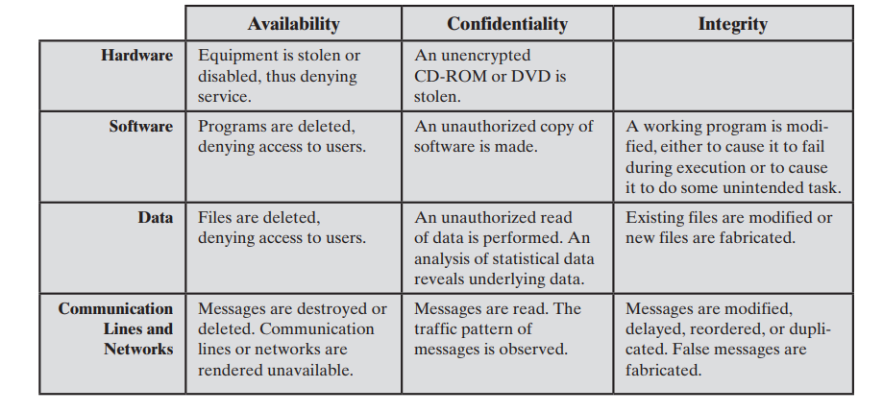
Let’s Combine Assets and Attacks

